Slide 1
Broadband Billing Management System
Data Structure, CSE-135
Section: 61_K

Slide 2

Project Overview
Online Billing System in C
Manage customer details (phone number, name, pending amount)
Track customer payments

Slide 3
Billing System Program in C using Data Structure
This is an overview of an Billing System Program in C using Data Structure. It provides an introduction to the program and its features, such as managing customer data, tracking payments, and modifying customer information. The program stores data using .ojs extension files and includes functionalities like real-time payment tracking, pending amount display, and robust file handling. The presentation also covers the advantages, disadvantages, and future scope of the project.

Slide 4

Objectives
Data storage using .ojs extension files
Managing the informations

Slide 5
Raw Code
Payment processing
Searching and showing
details
Input of customer details
Modification of customer information
File handling (.ojs extension)

Slide 6
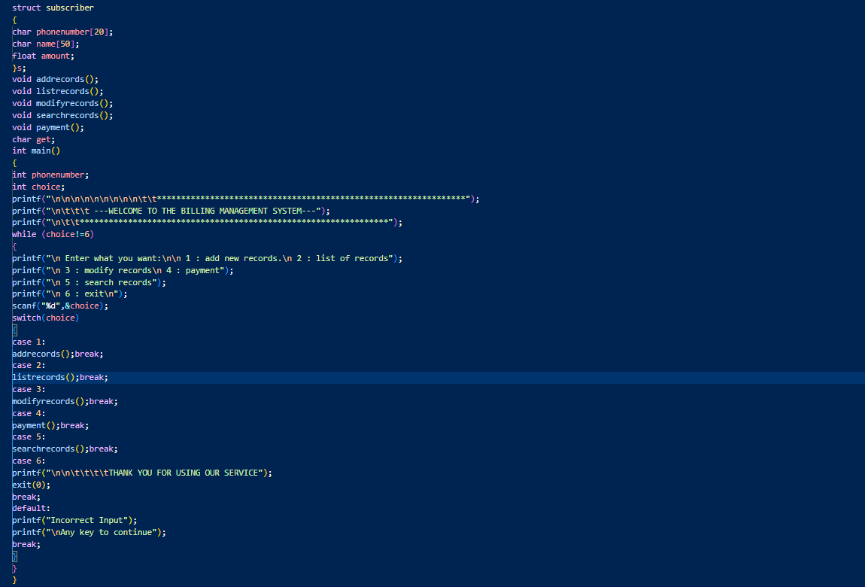

Slide 7
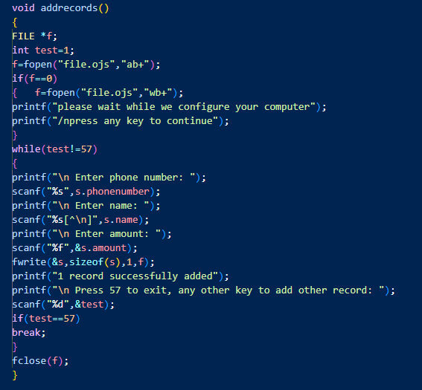
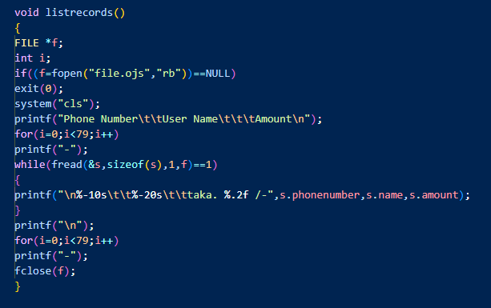

Slide 8
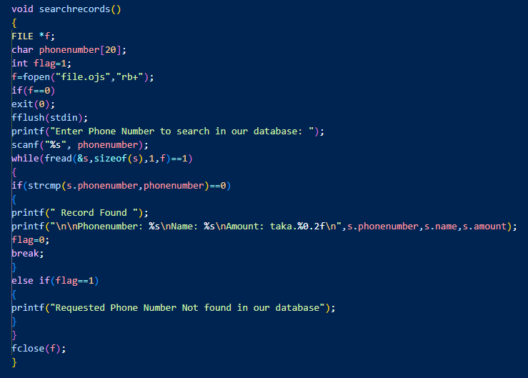

Slide 9
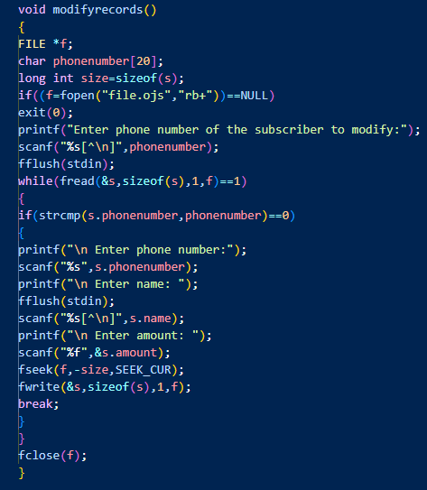
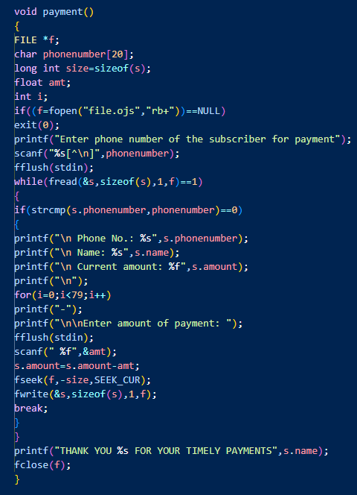

Slide 10
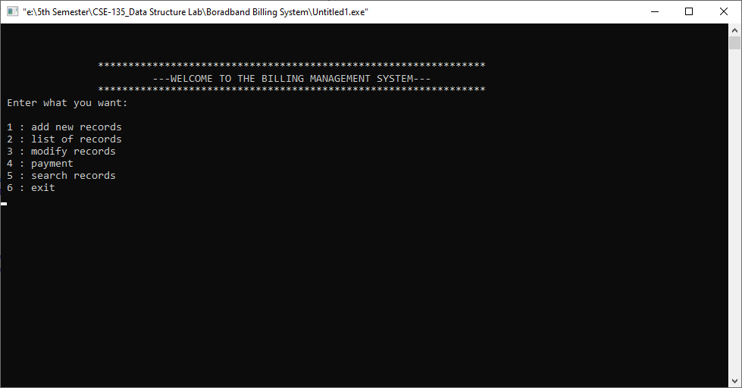
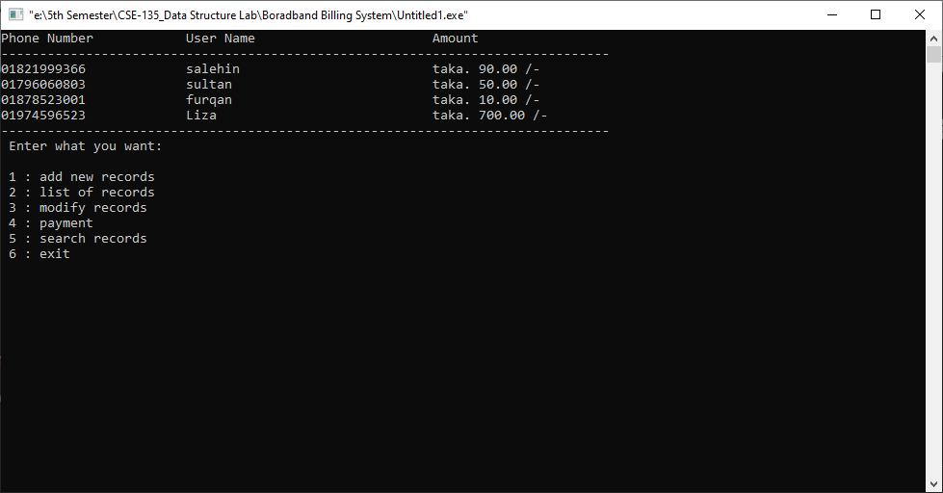
Features and Outputs
Customer data management
Real-time payment tracking
File-based data storage

Slide 11

Advantages
Efficiency:
Quick customer data retrieval
Seamless payment tracking
Reliability:
Robust file handling
Minimal data loss

Slide 12

Disadvantages
Potential security concerns (file access)
Dependency on file system

Slide 13
Future Scope
Integration with a graphical interface
Cloud-based data storage options
Enhanced security features
Mobile application development

Slide 14
Team Members
Sultanus Salehin
ID: 221-15-5357
MD Arham Tabib
ID: 221-15-5707
Sumiya Sabrin Liza
ID: 221-15-5768

Slide 15
Thank you. Please feel free to ask any questions. 😄

